Slide 1
Telecom Egypt Intelligent Assistant RAG-Powered Customer Service Chatbot
WE
Arabic & English
Local Deployment
Source Citations
Multi-format Docs

Slide 2
Problem & Objective
The Problem
Our Solution
Thousands of daily customer inquires
Long wait times for support
Repeated questions about packages & billing
No 24/7 automated Arabic support
Agents spend time on simple FAQs
RAG Chatbot trained on te.eg
Arabic, English & Egyptian dialect
Available 24/7 – no human needed
Grounded answers with source links
Upload extra docs for context

Slide 3
System Architecture
1- Data Ingestion Pipeline
Te.eg
Website
source
Scraper
BeautifulSoup
Chunker
Langchain
Embeddings
Nomic-embed
ChromaDB
Vectore Store
2- Query Pipeline
User
Question
Embed
Query
Retrieve
Top-6
LLM
Llama3.2:3b
Answer +
Source
MMR Retrieval – reduces redundancy in results
Tech stach:
LangChain
ChromaDB
Ollama
Streamlit
BeautifulSoup
Langdetect

Slide 4
Key Features
Multi-llngual
Source Citations
Document Upload
Arabic, English & Egyptian dialect – auto-detect with langdetect
Every answer shows te.eg source links – no hallucination
PDF, DOCX, TXT, HTML & Images (OCR) added to knowledge base
On-premises
MMR Retrieval
Chat Interface
100% local – ollama + ChromaDB, no cloud, no API keys
Maximal Marginal Relevance reduces redundant context
Professional Streamlit UI with conversation history

Slide 5
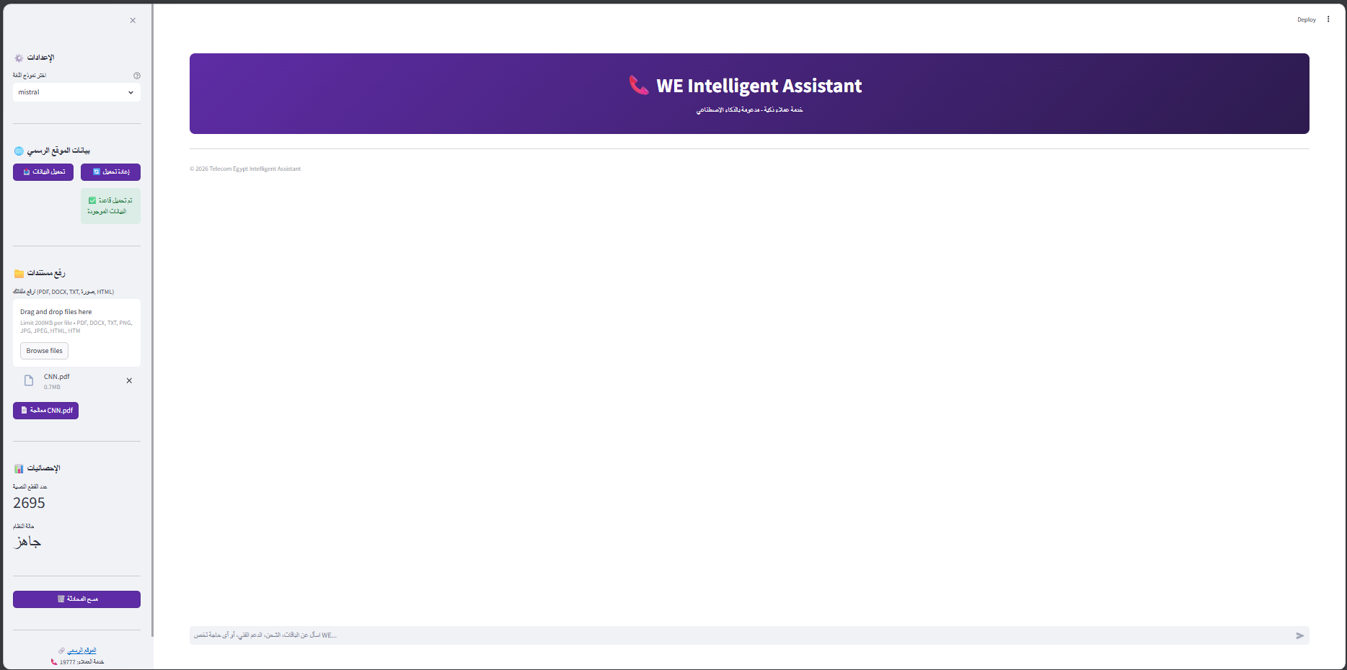
Live Demo – Interface
Live Demo – User Interface
Streamlit-based UI with Telecom Egypt branding and real-time interaction

Slide 6
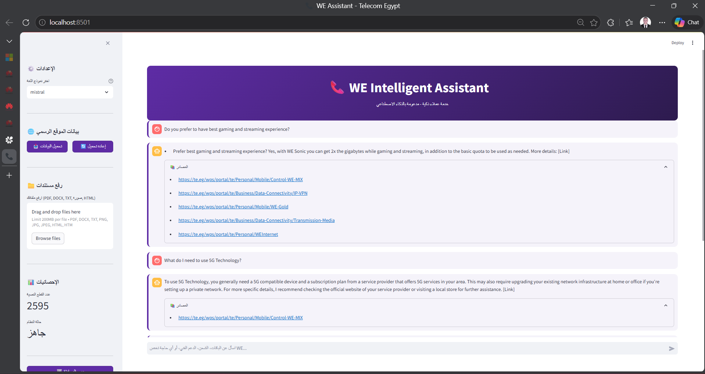
Live Demo – Interface
Live Demo – Question & Answer
Supports Arabic, English, and Egyptian dialect with grounded answers

Slide 7
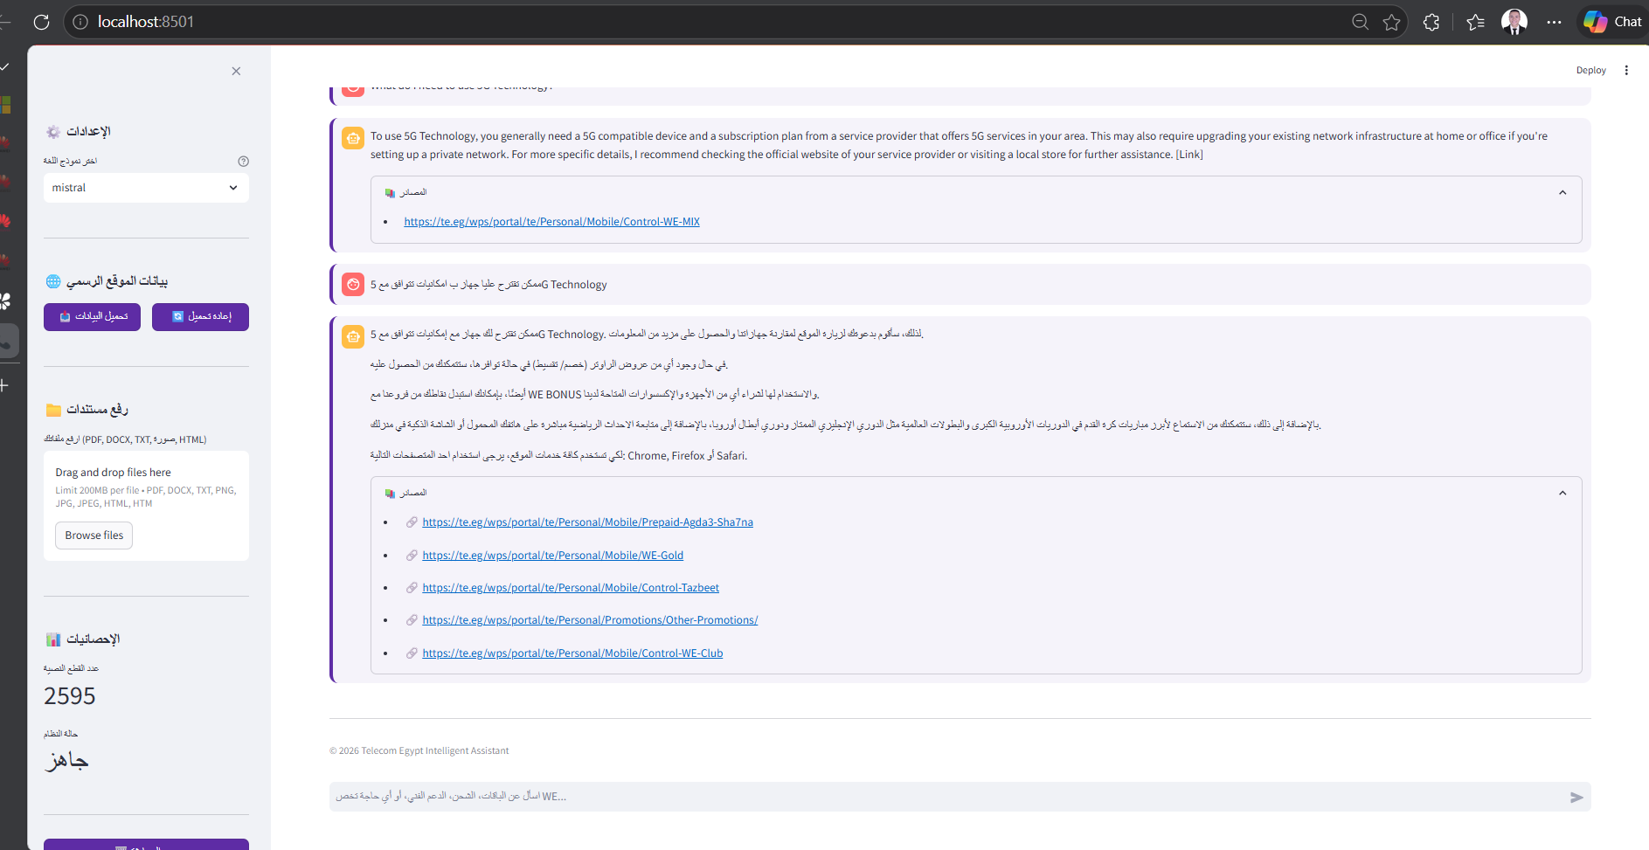
Live Demo – Interface
Live Demo – Question & Answer
Supports Arabic, English, and Egyptian dialect with grounded answers

Slide 8
How it Works – User Flow
1
2
3
4
5
Python Scraper.py Collects ~40 pages from te.eg
Ollama serve Loads LLM + Embeddings locally
Streamlit run app.py Opens at localhost:8501
Click ‘تحميل البيانات’ Builds ChromaDB
( ~2 min)
Arabic or English Get grounded answers
Run Scraper
Start Ollama
Launch App
Load Data
Ask Questions

Slide 9
Challenges & Solutions
Challenges & Solutions
Challenge | Solution
Hallucination | RAG + Source filtering
Arabic dialect | Custom prompt + langdetect
Encoding errors | clean_text()
Large documents | Chunking
Telecom Egypt Intelligent Assistant | Built on te.eg | On-premises RAG | 2026

Slide 10
Deliverables & Conclusion
Required Deliverables
Deliverable | Status | Details
Working Interface | Done | Streamlit App + Localhost:8501
Python Notebook | Done | Complete code with explanations
Presentation | Done | This PPT with System overview
README / Documentation | Done | Setup + Usage Instructions
Key Takeaways
Fully local RAG System – zero cloud dependency, data stays on-premises
Handles Arabic, English & Egyptian dialect automatically
Grounded responses – answers bounded by official te.eg content only
Extensible – users can upload additional documents at runtime
Production-ready architecture-scales with more URLs and documents
Telecom Egypt Intelligent Assistant | Built on te.eg | On-premises RAG | 2026

Slide 11
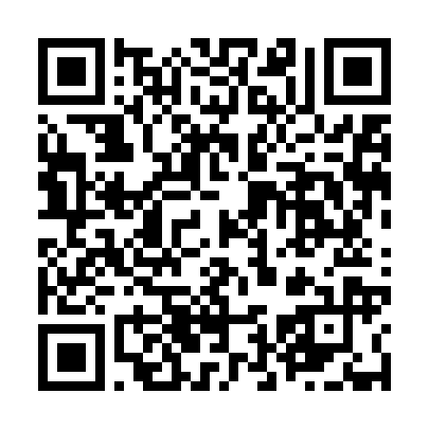
Project Repository
GitHub Repository:
https://github.com/Youssef1Moustafa/RAG-Powered-Customer-Service-Chatbot
Includes:
- Full Source Code
- RAG Pipeline
- Streamlit App
- Documentation & Setup

